Slide 1

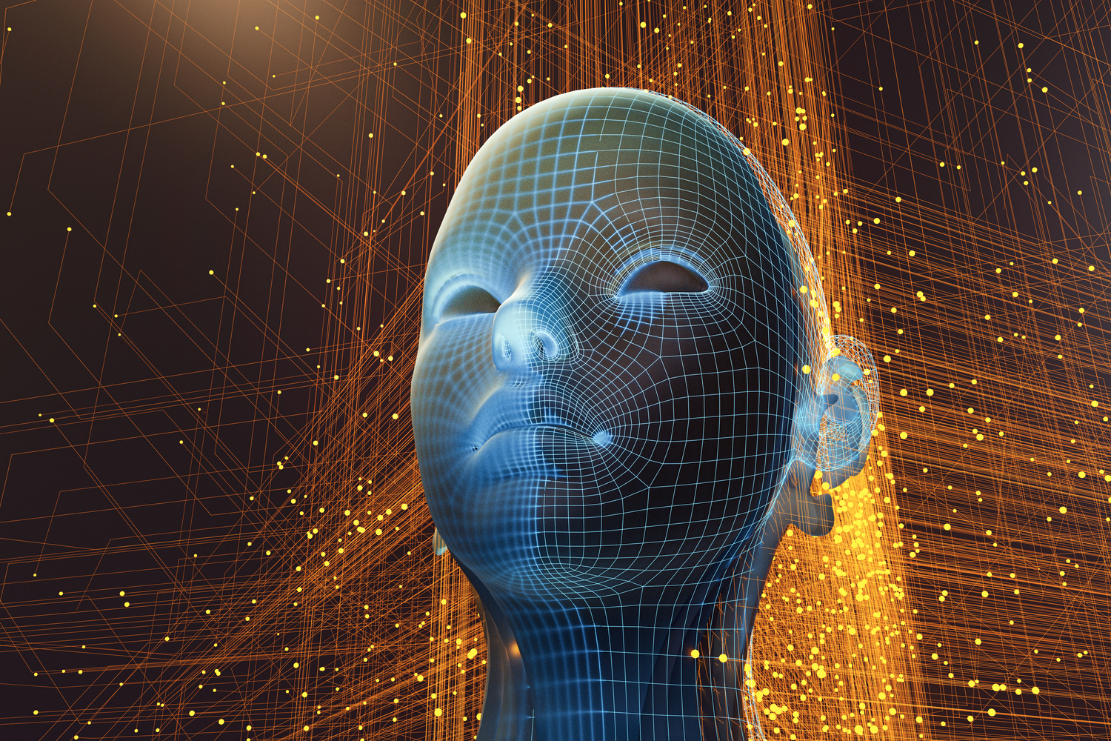

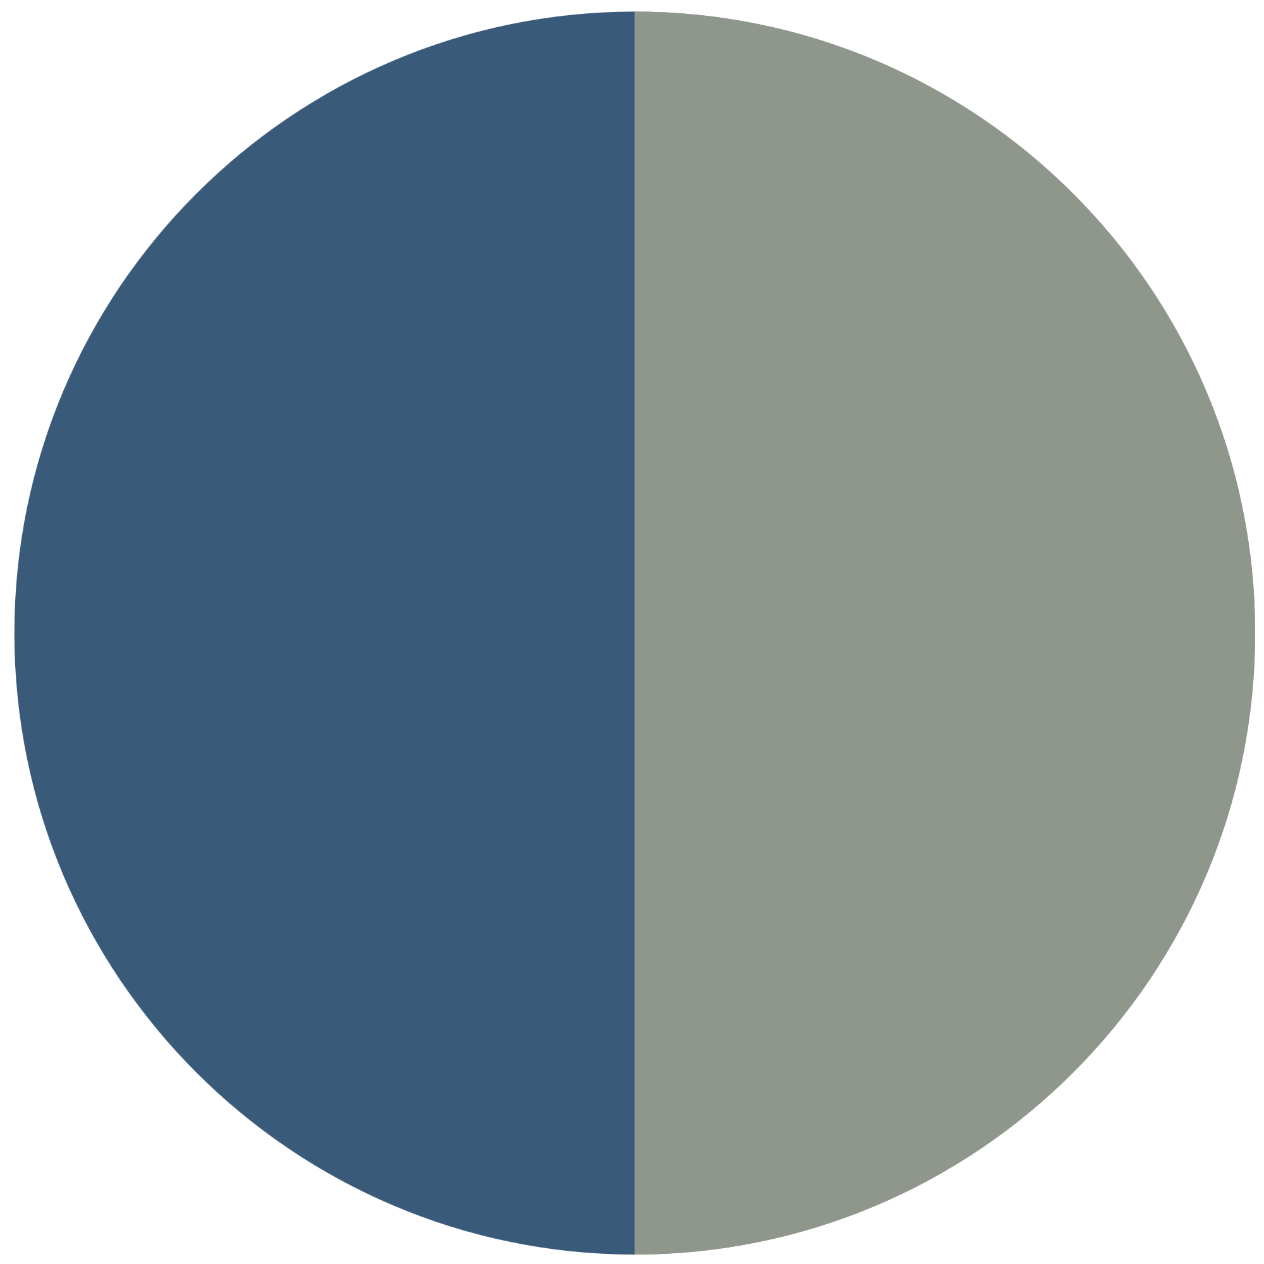



Emotion Recognition from Multimodal Media Content
Presented By:
Md.Mahfujul Karim Sheikh
Prerona Tanjin Kotha

Slide 2

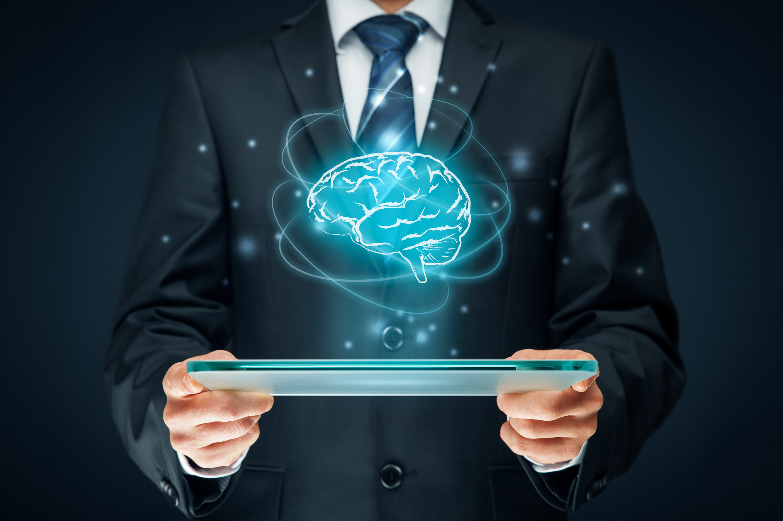
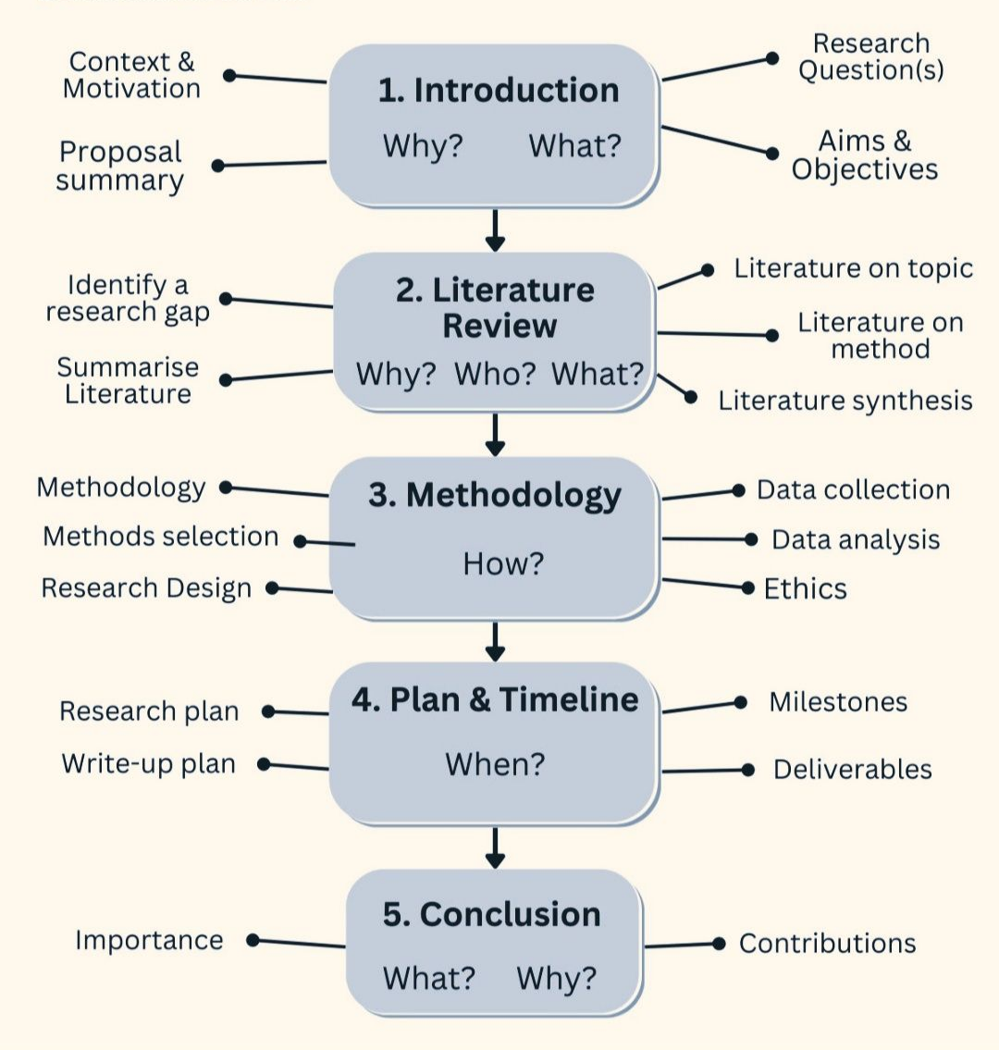
Full Roadmap

Slide 3


Motivation
Importance of Emotion Recognition
Benefits Across Disciplines
The Role of Technology
Advanced technologies, including deep learning, have enabled more accurate and efficient emotion recognition. These tools help analyze multimodal data, ensuring a comprehensive understanding of emotional expressions.
Recognizing emotions can transform sectors like customer service and mental health support. By accurately interpreting emotional states, businesses and professionals can better address needs and improve overall satisfaction and outcomes.
Emotion recognition is vital in enhancing human-computer interaction and understanding behavioral dynamics. It allows for improved communication and tailored experiences in various applications such as healthcare, marketing, and education.

Slide 4
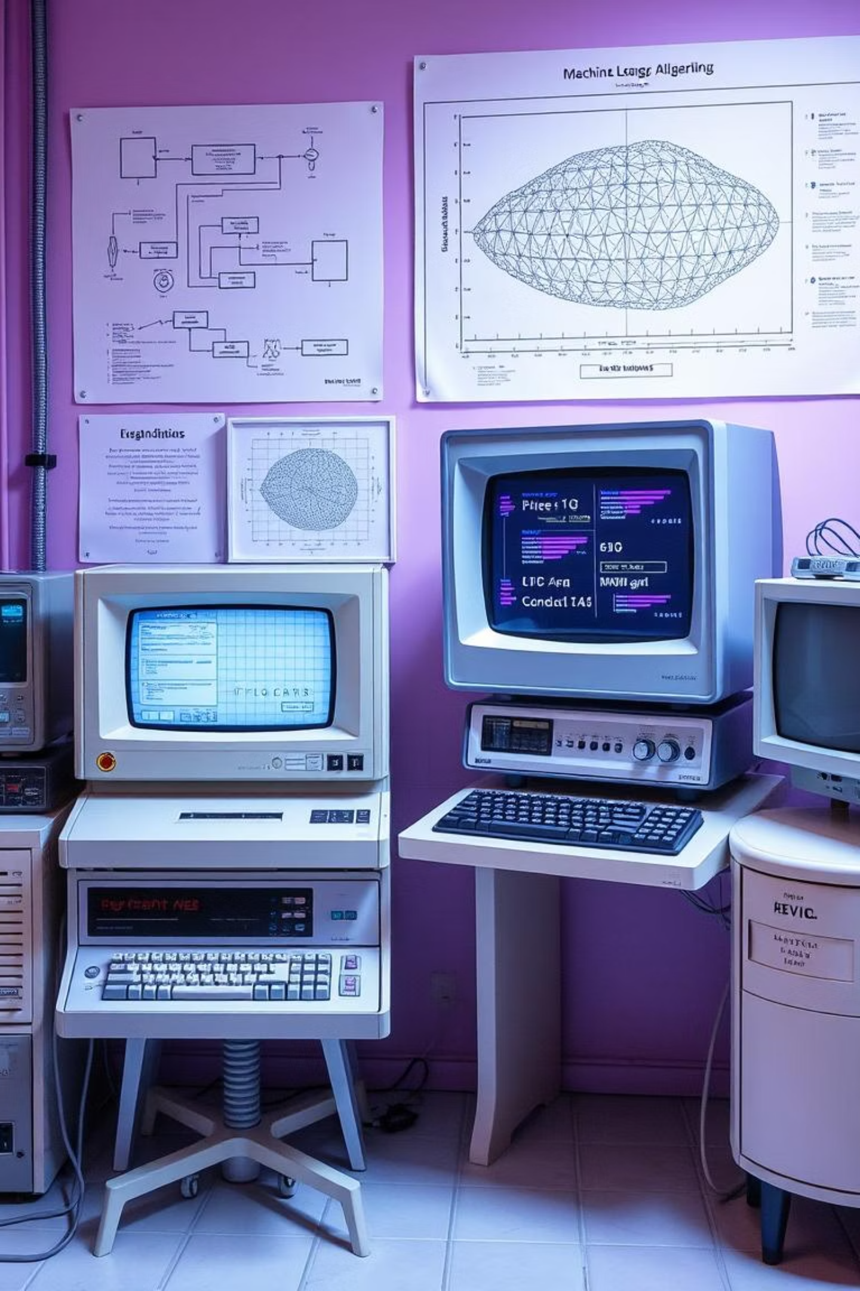


Literature Review: Historical Context of ER
Emotion recognition research has a long history, predating the recent surge in AI advancements.
Early Efforts
Relied on traditional machine learning algorithms, emphasizing manual feature extraction from modalities like facial expressions, speech patterns, and physiological signals.
Limitations
These methods were often constrained by human biases in feature engineering and a limited feature space, hindering comprehensive emotional understanding.

Slide 5





Literature Review: Categorization - Unimodal Approaches
Facial Expression Recognition
Speech Emotion Recognition
Physiological Signals
Primary nonverbal communication (55% of communication). Pioneering work by Ekman et al. on six basic emotions. Early methods include Gabor wavelets, LBP, WLD.
Analyzes vocal characteristics such as pitch, amplitude, and spectral tilt to infer emotional states from spoken language.
Objective but less overt. Includes analysis of heart rate variability, skin conductance, and brain activity (e.g., EEG readings).
Overall Unimodal Limitation: Struggles to accurately judge emotion due to the complex interplay of cues and vulnerability to noise. Capturing the full spectrum of human emotion requires more.

Slide 6
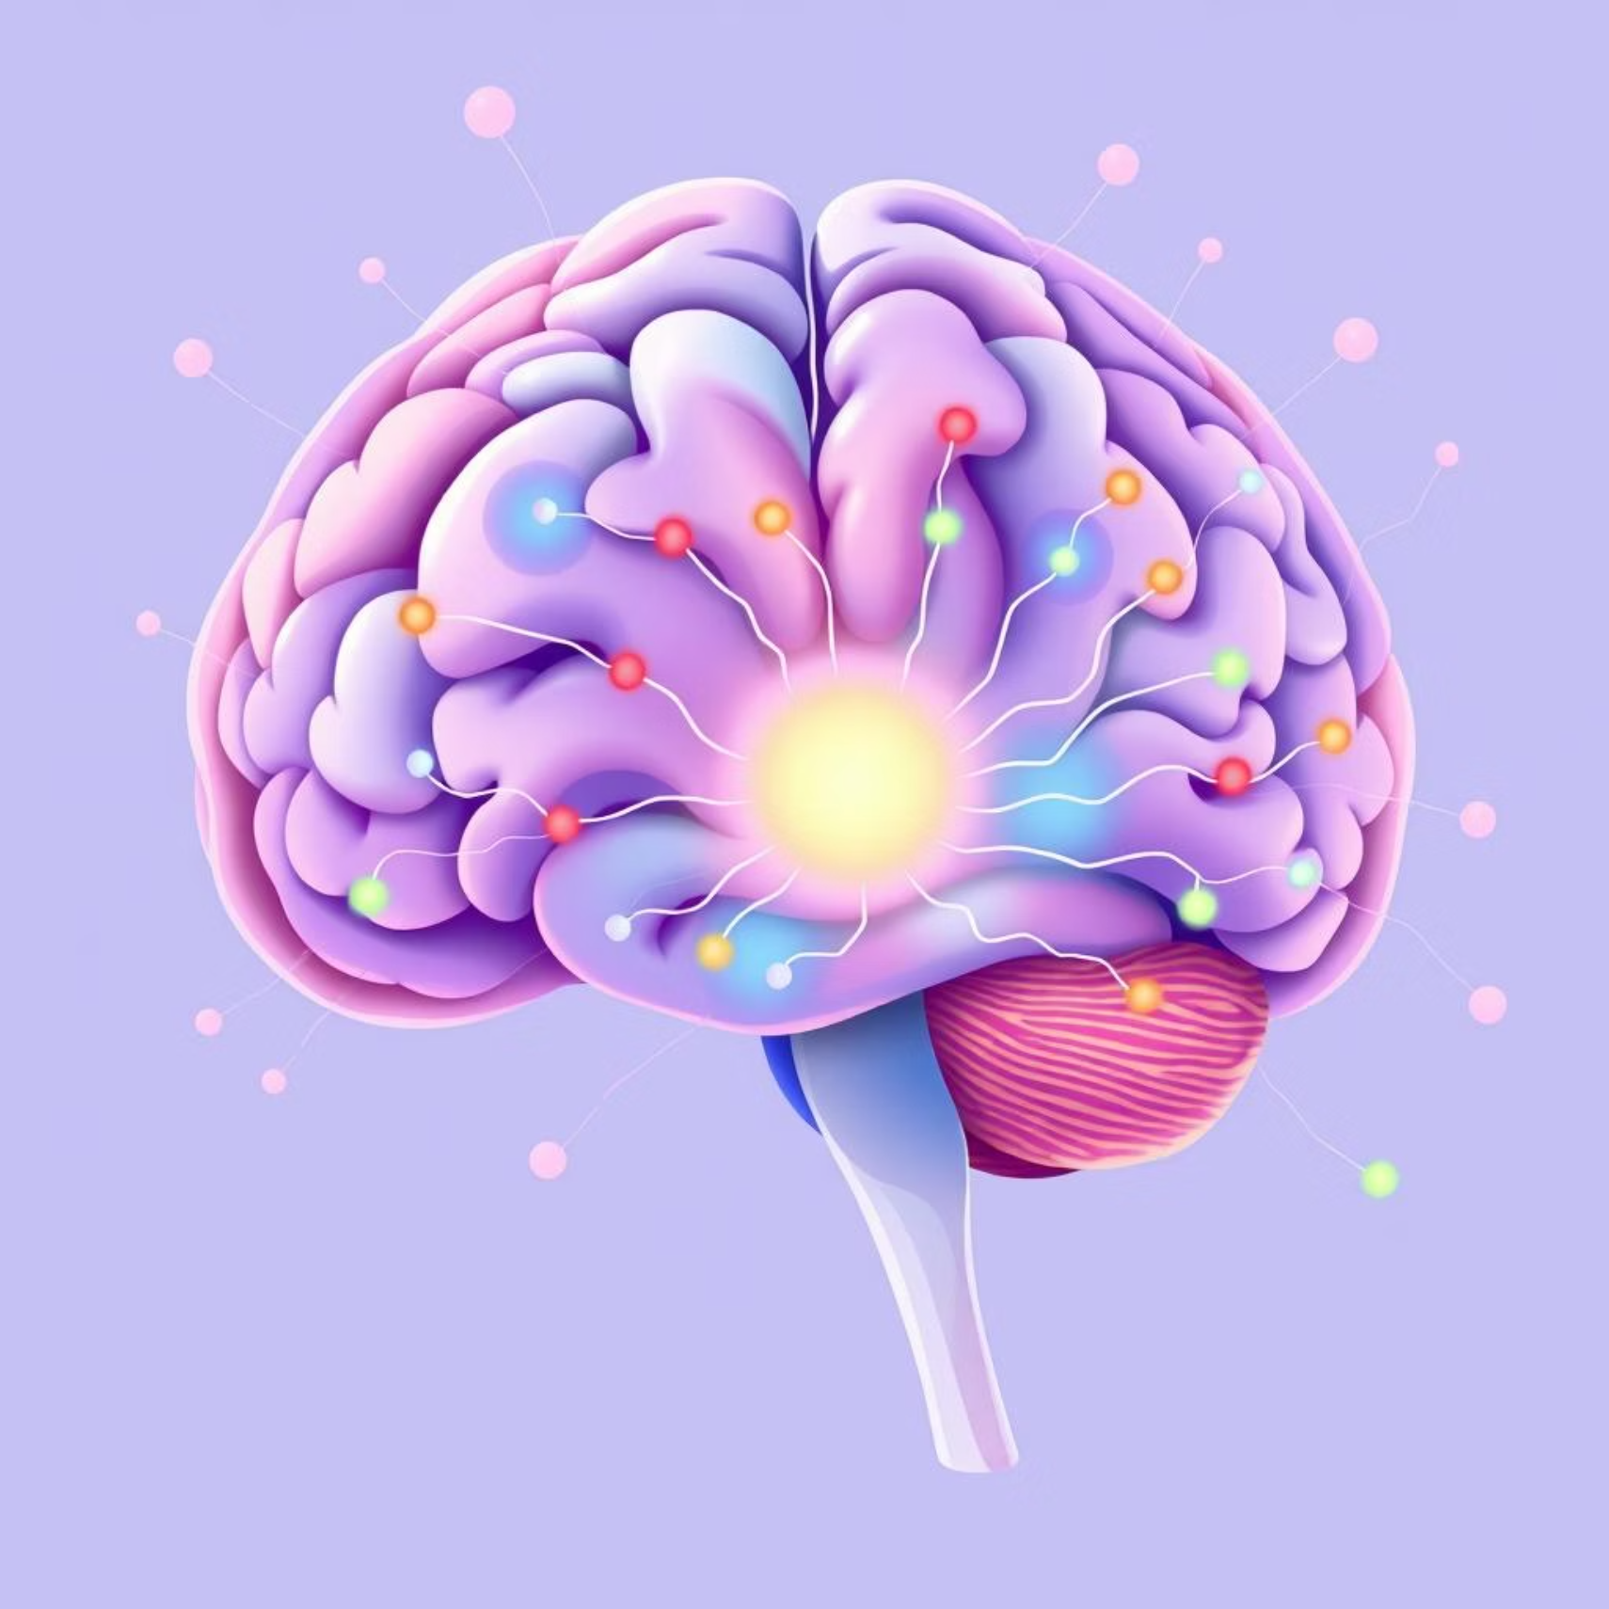
Literature Review: Categorization - Multimodal Approaches
Recognition: Human emotions are expressed through a rich combination of signals, making unimodal approaches insufficient.
Goal of MER: Integrate information from sound, language, images, and physiological data for comprehensive and accurate understanding of human emotion.
Combinations: Common integrations include facial expressions + audio, audio + written text, and physiological signals + visual cues.
Crucial for: Achieving a complete and nuanced comprehension of human emotions in real-world scenarios.

Slide 7

Unimodal vs. Multimodal Datasets
Speech Recognition
Autonomous Driving
LibriSpeech
TIMIT
ESC-50
UrbanSound8K
VoxCeleb
IEMOCAP
CMU-MOSEI
SEED
DEAP
EIMT16
MELD
EXTENDED COGNIMUSE
EXTENDTED MUSIC VIDEO DATASET
MNIST
CIFAR-100
ImageNet
Fashion-MNIST
COIL-20
Basic Image Classification
Sentiment Analysis from Text and Audio

Slide 8









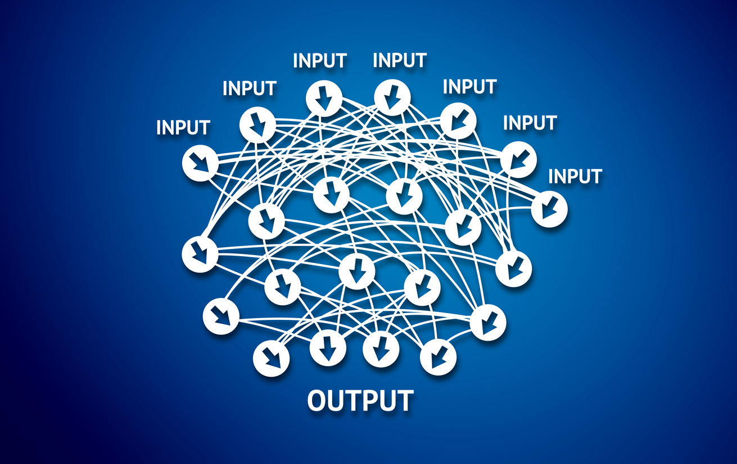
Technical Overview: Feature Extraction - Textual & Visual
Textual Modality
Visual Modality (Video Frames/Facial Expressions)
Capturing semantic and contextual information from dialogue is crucial for understanding underlying emotions.
Visual cues from video frames and facial expressions offer critical information for emotion recognition.
Word Embeddings
Frame Analysis
Pre-trained language models like
ALBERT-base.
CNNs (VGG19) for raw video frames and Mel spectrograms.
ResNet-50, RGB-stream I3D for spatio-temporal features.
Captures token-level meaning.
Facial & Motion Analysis
Sentence Embeddings
MTCNN for robust face detection.
GPT for comprehensive contextual understanding.
RNNs/GRUs for temporal relationships in
expressions.
Considers dialogue history, current sentence, and reply.
FlowNetS for subtle motion features.

Slide 9

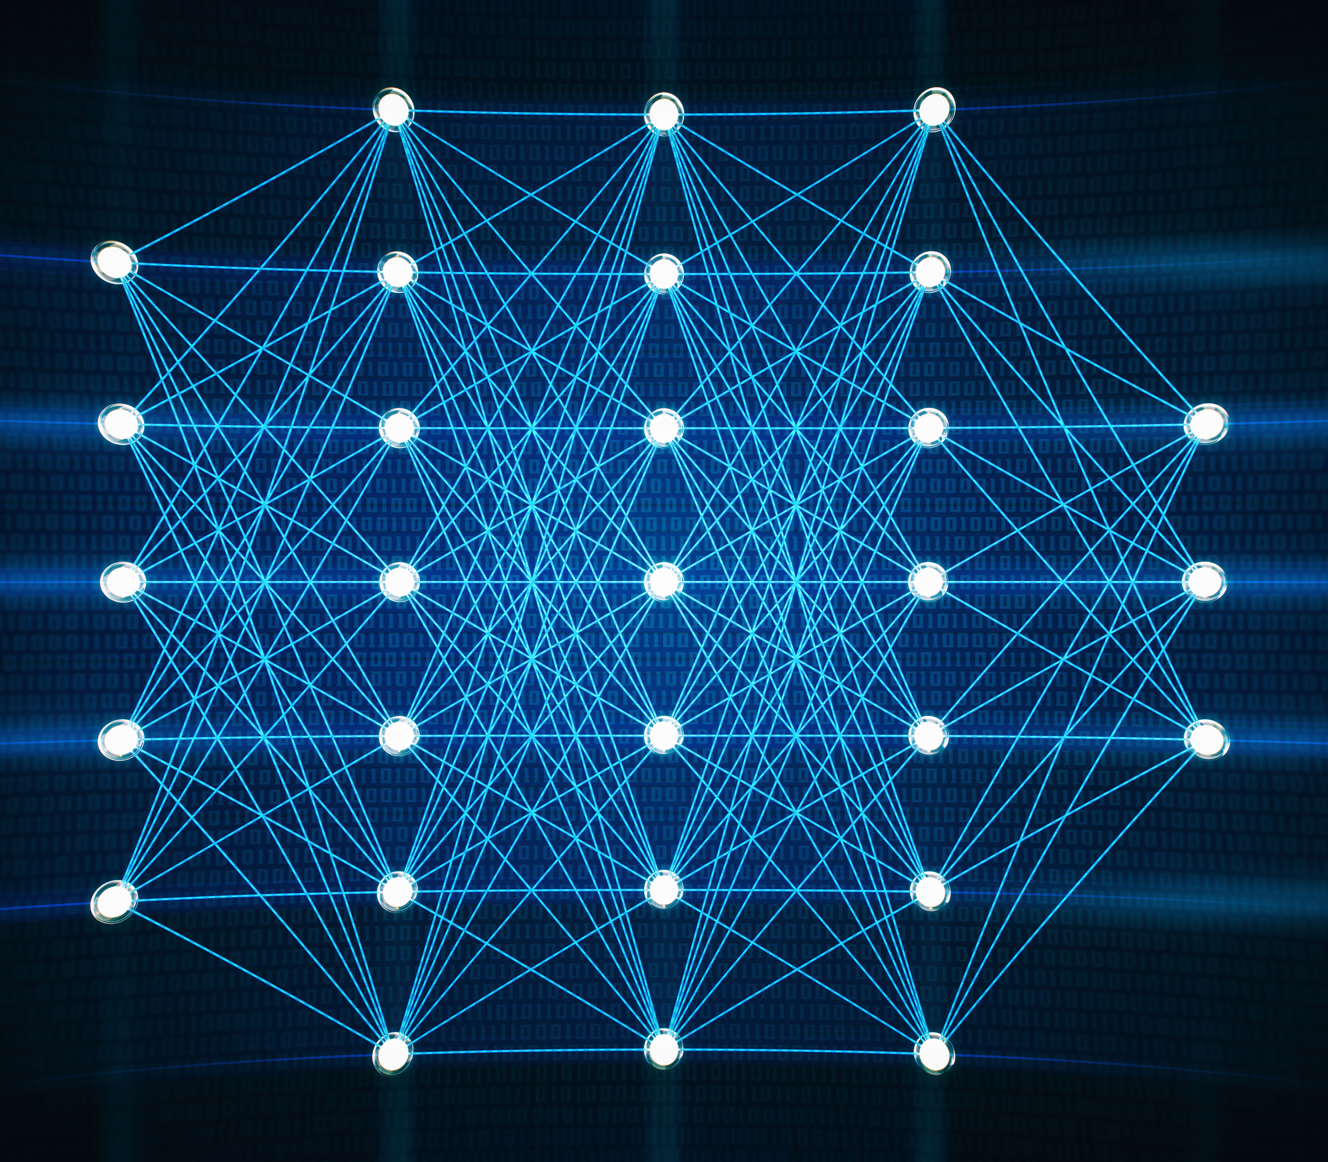





Technical Overview: Deep Learning Architectures
CNNs
RNNs & LSTMs
Transformers
Cornerstone for grid-like data (visual, acoustic, EEG), learning hierarchical spatial features effectively.
Adept at sequential data, capturing temporal information from speech and video sequences.
Revolutionized sequence-to-sequence tasks with multi-head self-attention for temporal and cross-modal fusion.
Autoencoders
Hybrid Models
Unsupervised learning for efficient data representations and shared features from physiological signals.
Combine CNNs, RNNs, and Transformers for robust feature extraction and integration.
These architectures form the backbone of advanced MER systems, each contributing unique strengths to processing diverse data types.

Slide 10

Transformer Model

Slide 11
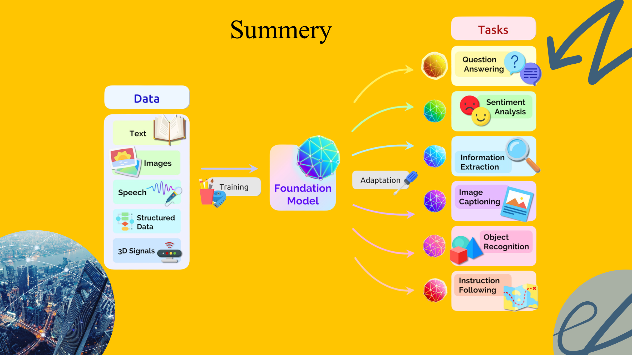

Slide 12
Comparative Study of Multimodal Emotion Recognition Systems
Recent advancements highlight the diverse approaches and performance metrics across different datasets and modalities.
Le et al. (2023)
Video, Audio, Text + Transformer
85.9%
IEMOCAP
Xiong et al. (2025)
EEG + CNN-KAN-F2CA
97.9%
SEED
Xie et al. (2021)
Conversational MER + EmbraceNet
65%
MELD
Zhang et al. (2024)
Speech, Text + Gated Multimodal Unit
78.2%
MOSEI
Chen et al. (2022)
Facial, Audio + Attention Fusion
81.5%
MSP-IMPROV
Performance varies significantly based on the chosen modalities, fusion architecture, and the emotional complexity and annotation quality of the dataset. EEG-based methods often show higher accuracy for valence/arousal due to direct physiological signals.

Slide 13
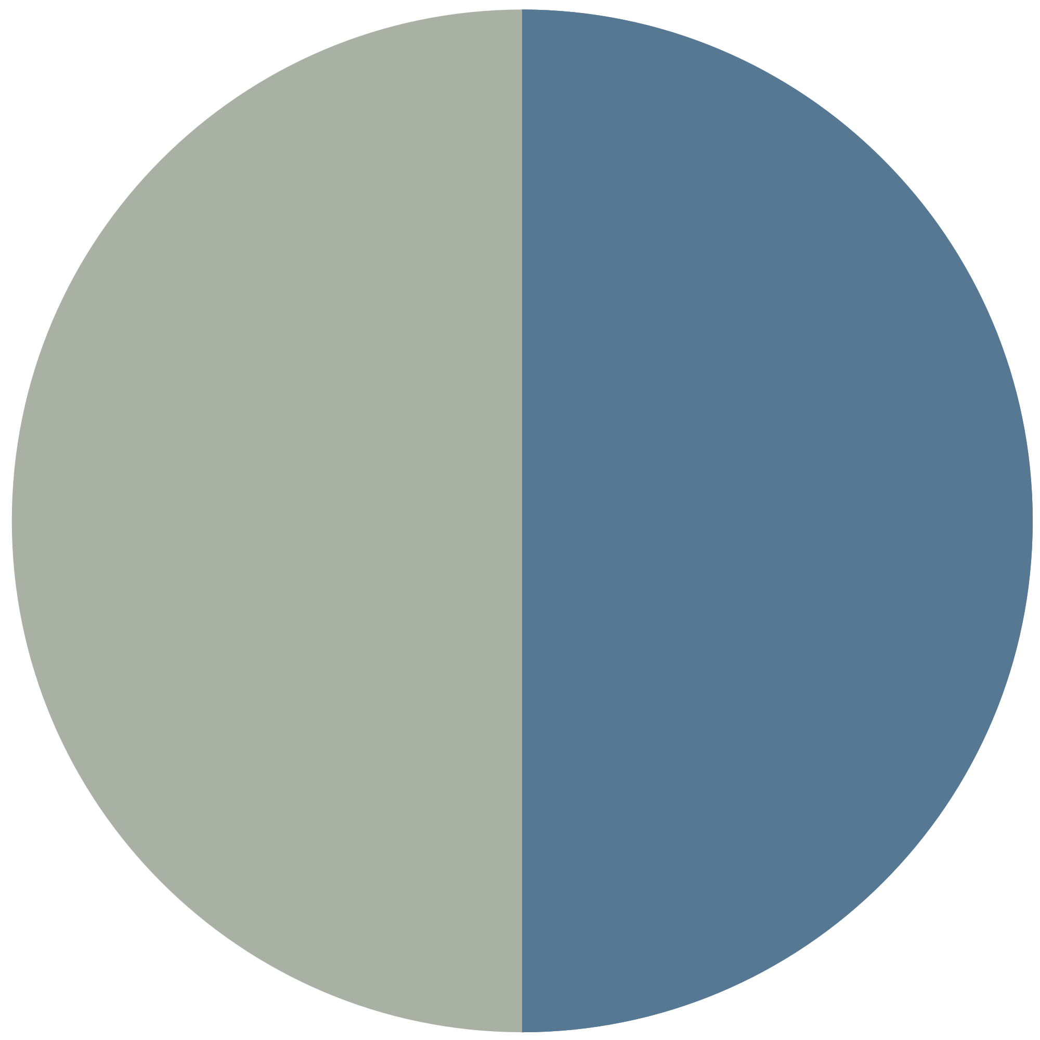




Key Applications of Emotion Recognition
Mental Health Monitoring
Customer Experience Enhancement
Content Personalization
Businesses utilize emotion recognition to analyze customer reactions, improving service quality and tailoring experiences, which leads to higher satisfaction and loyalty rates.
Emotion analysis helps content creators deliver personalized media experiences, ensuring that users receive engaging and relevant content based on their emotional responses and preferences.
Emotion recognition technology can significantly aid in mental health assessments by detecting emotional states, enabling timely interventions and personalized therapies for patients.

Slide 14
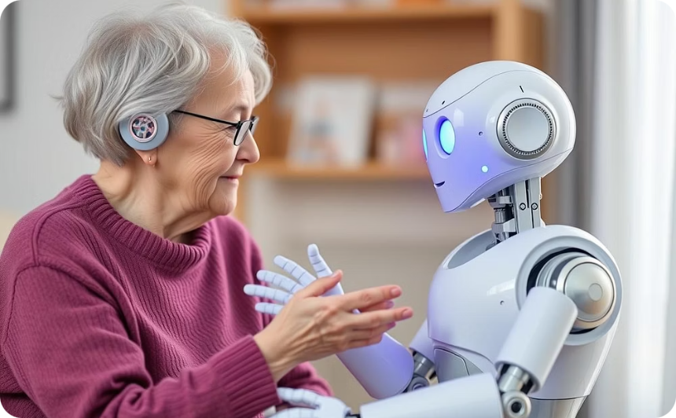
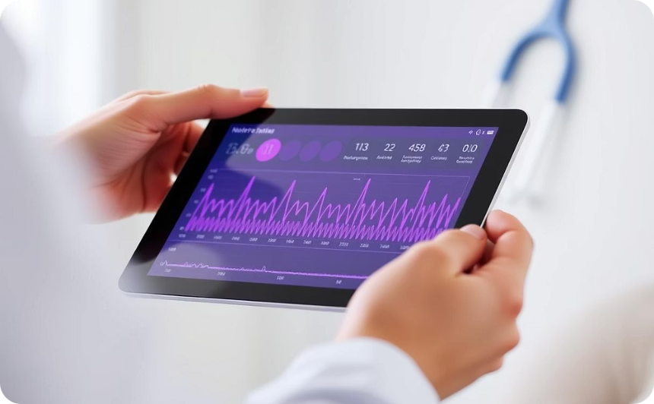

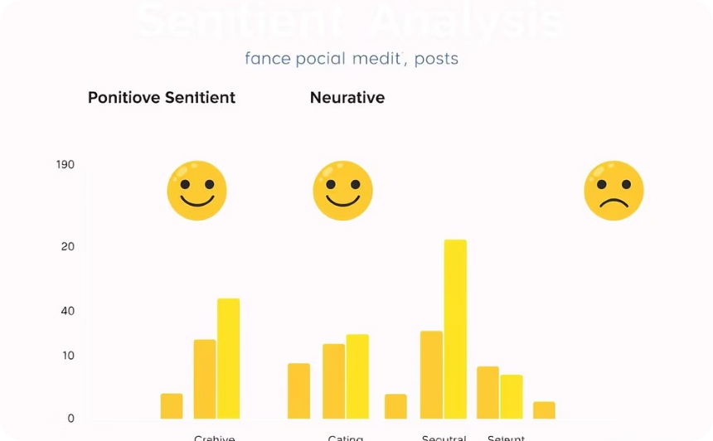
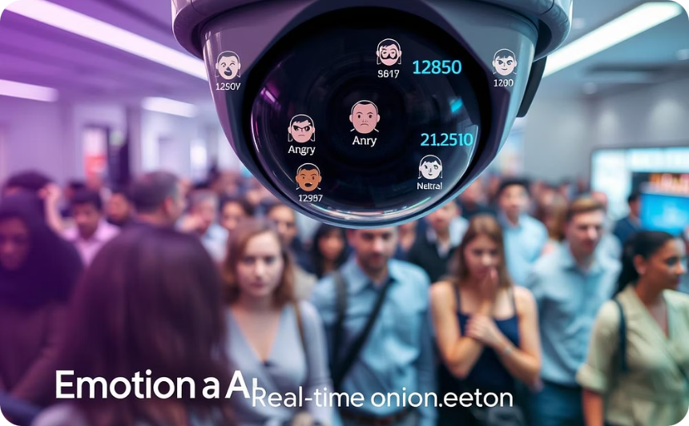
Applications of
MER
Robotics & Intelligent Systems
Healthcare & Well-being
Enabling Socially Assistive Robots (SARs) to interpret human affect and respond emotionally, fostering natural human-robot communication.
Monitoring emotional status for mental health and general well-being, aiding in earlier intervention and personalized care.
Security & Safety
Education & Learning
Implementing smart protection systems, driver monitoring for safety, and lie detection capabilities for enhanced security control.
Social Media Analysis
Developing adaptive learning systems that respond to student emotions, optimizing educational pathways and improving engagement.
Analyzing user-generated video content and social networking data for sentiment and emotion, enhancing content creation and recommendation systems.

Slide 15



Challenges in Emotion Recognition
Data Privacy Concerns
Balancing user privacy with data collection is critical, as sensitive emotional data raises ethical issues for individuals and organizations.
Variability in Emotional Expression
Individuals express emotions differently, influenced by cultural backgrounds, personal experiences, and contextual factors, complicating accurate emotion recognition.
This section explores key obstacles in emotion recognition technology.
Limited Contextual Understanding
Current models often struggle to comprehend context, which is essential for interpreting emotions accurately in diverse scenarios and interactions.
Technological Limitations
Existing algorithms may lack the necessary robustness and adaptability to handle the complexity of multimodal data in real-world applications.

Slide 16


Research Gaps and Future Directions in Emotion Recognition
Despite advancements in emotion recognition, several research gaps remain. Key areas for exploration include enhancing multimodal fusion techniques, improving data diversity, and tackling ethical implications in AI use, which can drive more robust and fair systems in future applications.

Slide 17
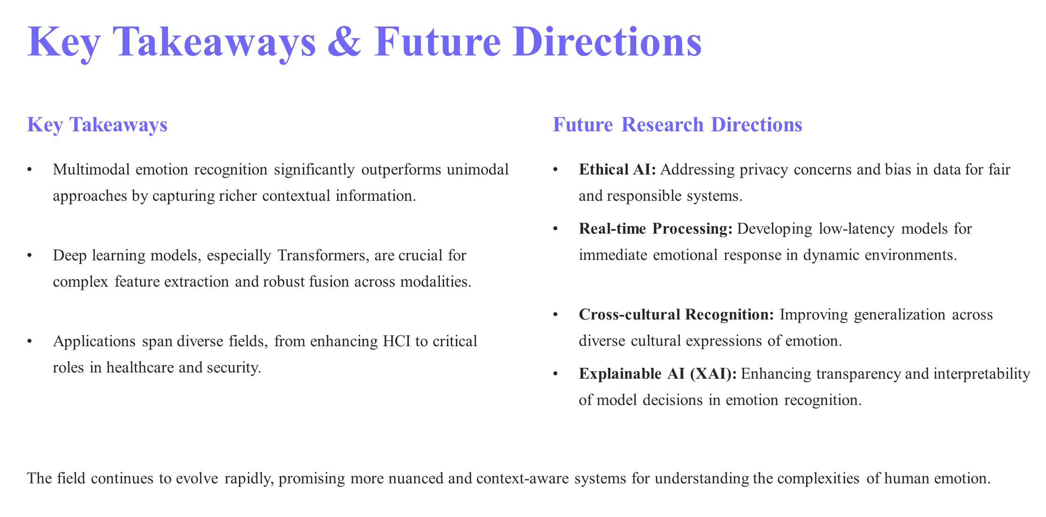



Slide 18





Questions and Feedback?
Thank you for your attention! Please share your thoughts or ask any questions.
Email
Mahfujul_cse735@nubtkhulna.ac.bd
Social Media
www.bio.link/mahfuj735
Phone
+8801726725791

